Slide 1

Infrastructure, Race, and Urban Change in Brazil – Who Benefits?
Constructing a National Database of Major Infrastructure Projects
Fabio Schreiber¹,
Lorena Melgaço¹,
Luana Xavier Pinto Coelho²,
Philipp Stark¹
¹Lund University, Lund, Sweden;
²University of Brasília, Brasília, Brazil
Lund Social Sciences Methods Centre

Slide 2
The Problem
Large infrastructure investment is promoted as urban development.
However, it is unclear who benefits from them.
Urban planning in Brazil is usually framed by class, rarely by race, behind a claim of "planning innocence.”
This project links investment to racial composition, spatially and over time.
Lund Social Sciences Methods Centre

Slide 3
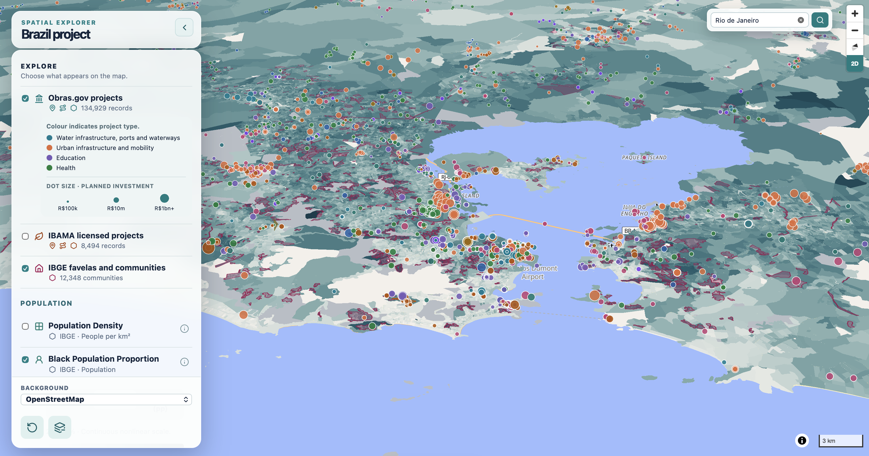
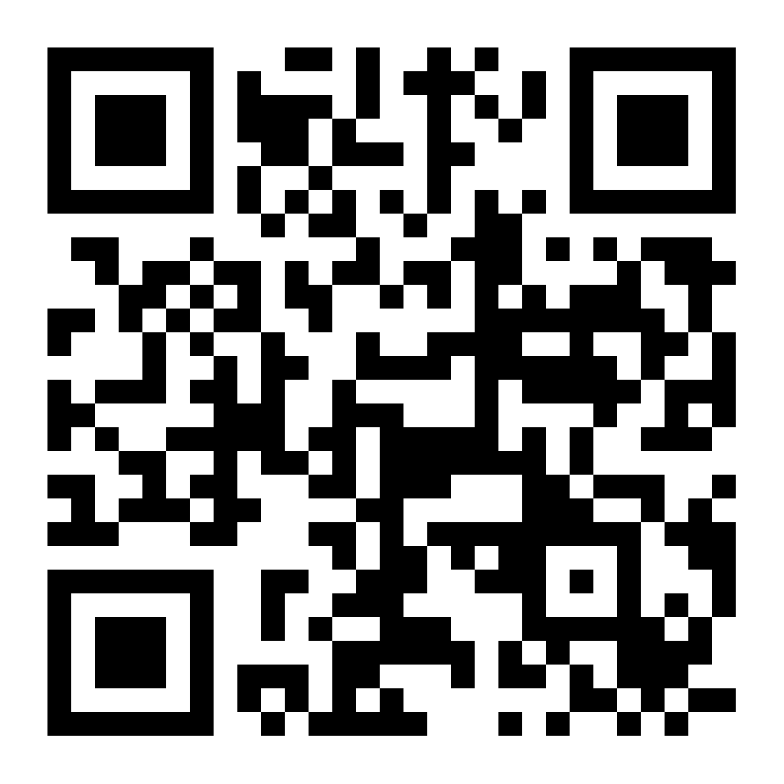
An Interactive Platform
DATA INPUTS
Federally funded projects (Obras.gov)
IBAMA-licensed projects
IBGE Census 2010 & 2022
IBGE favelas and communities
COMMON AREAS
Areas harmonised to track change across census years
WHAT IT ENABLES
Area-level analysis of investment, race, income, housing and basic services over time.
Scan to explore
Lund Social Sciences Methods Centre

